Slide 2
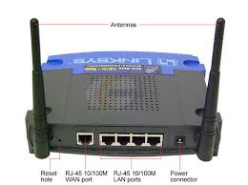
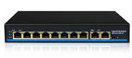
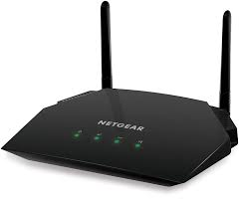
Some Internetworking devices

Slide 3
OSI and TCP / IP
OSI model gives guidelines on how communication needs to be done, while TCP/IP protocols layout standards on which the Internet was developed. So, TCP/IP is a more practical model.
TCP/IP model is a protocol-oriented standard.
The OSI has seven layers while the TCP/IP has four layers.

Slide 4
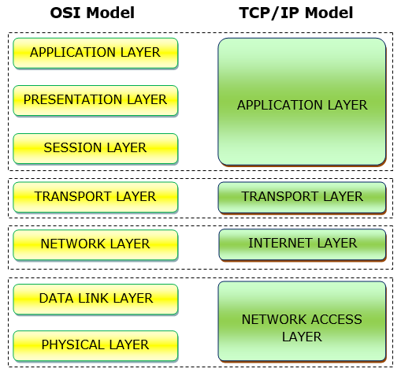
OSI and TCP / IP

Slide 5
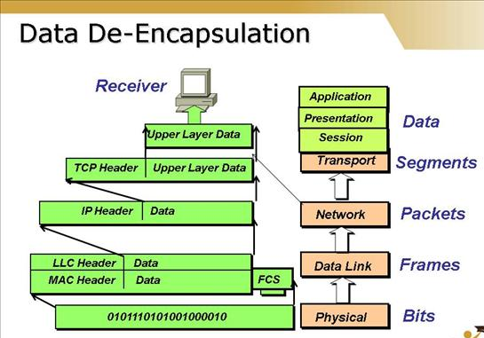

Slide 6
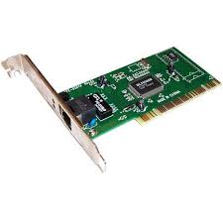
Network Interface Card
hardware component without which a computer cannot be connected over a network.
It is a circuit board installed in a computer that provides a dedicated network connection to the computer.
It is also called network interface controller, network adapter or LAN adapter.

Slide 7
Network
LAN : spans a relatively small area
WAN : often established with leased telecommunication circuits
Difference in LAN and WAN

Slide 8
Network
Circuit Switching
dedicated communications path is established between two stations through the nodes of the network.
path is a connected sequence of physical links between nodes.
On each link, a logical channel is dedicated to the connection.
Data generated by the source station are transmitted along the dedicated path as rapidly as possible.
At each node, incoming data are routed or switched to the appropriate outgoing channel without delay.
The most common example of circuit switching is the telephone network.

Slide 9
Network
Packet Switching
not necessary to dedicate transmission capacity along a path
through the network. Rather, data are sent out in a sequence of small chunks, called packets.
Each packet is passed through the network from node to node along some path leading from source to destination.
At each node, the entire packet is received, stored briefly, and then transmitted to the next node.

Slide 10
Network
Frame Relay: packet-switching telecommunication service designed for cost-efficient data transmission for intermittent traffic between local area networks (LANs) and between endpoints in wide area networks (WANs).
ATM: difference between frame relay and ATM is that frame relay uses variable-length packets, called frames, and ATM uses fixed-length packets, called cells. Higher data rates than frame relay.
Wireless Networks: provide advantages in the areas of mobility and ease of installation and configuration

Slide 11
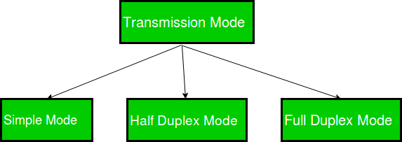
Data transmission modes

Slide 12

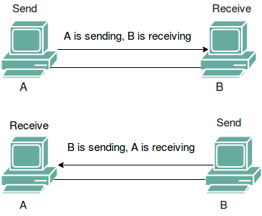
Data transmission modes
Half Duplex
Full Duplex

